Slide 1
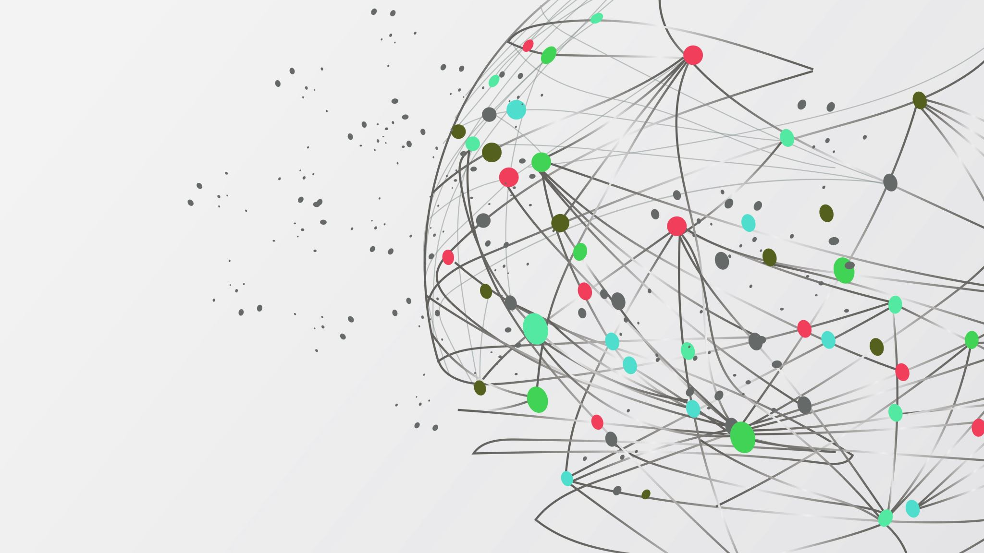
Hierarchical modelling
with EMC2
Niek Stevenson
MBNCSS 2026
Notes:
Timing: ~30 seconds.
Frame the lesson around one question: how do we learn about a population without pretending that participant estimates are noise-free?
Preview the route: pooling, measurement error, group inference, then EMC2's implementation.
[Sources]
- /Users/nstevenson/Documents/2026/BayesFlow_comp/mathpsych-editable-v7.pptx, slide 1 (visual template)

Slide 2

Psychological data are nested and noisy
• Repeated trials sit within people
• People differ in latent processes
• Trials are noisy
• Trial counts are often unequal
• Group-level claims are usually the goal
Notes:
Timing: ~1 minute.
Use a familiar repeated-measures example: many reaction times from each participant.
The hierarchy is not decoration; it mirrors how the data were generated and where the scientific question lives.
[Sources]
- /Users/nstevenson/Documents/2026/BayesFlow_comp/mathpsych-editable-v7.pptx, slide 2
- /Users/nstevenson/Documents/2026/MBNCSS26/Day2-Hierarchical/Model-Based Neuroscience & Cognition Summer School 2025.pptx, slides 3-11

Slide 3
A hierarchy links trials, people, and a population
Population parameters
μ, Σ
Participant 1
α₁
Participant 2
α₂
Participant I
αᵢ
Trials inform participant parameters.
Participant parameters inform μ and Σ.
The population regularizes uncertain participants.
Inference flows both ways.
trials
y₁
trials
y₂
trials
yᵢ
μ,Σ ∼ p(μ,Σ) αᵢ ∼ N(μ,Σ) yᵢ ∼ p(y | αᵢ)
Notes:
Timing: ~1.5 minutes.
Read the diagram top-down as a generative model, then bottom-up as posterior learning.
Participants are distinct, but connected through shared population parameters.
[Sources]
- /Users/nstevenson/Documents/2026/BayesFlow_comp/mathpsych-editable-v7.pptx, slide 4
- /Users/nstevenson/Documents/2025/EMC2_tutorial/LatexFiles/main.tex, Hierarchical Modeling section

Slide 4
Pooling is a modelling choice
NO POOLING
COMPLETE
POOLING
PARTIAL
POOLING
separate fits
identical
distinct + related
P1
P1
P1
Separate fits
• no information sharing
Complete pooling
• no individual differences
Partial pooling
• distinct estimates
• movement follows precision
P2
P2
P2
P3
P3
P3
local estimates
unchanged
all estimates
become equal
low-precision data
move farther
Local value
model estimate
Notes:
Timing: ~1.5 minutes.
Ask the room which participant should move most under partial pooling.
Stress that partial pooling is adaptive, not a fixed compromise: stronger data move less.
Separate fitting becomes problematic when the resulting point estimates are treated as error-free observations in a second analysis.
[Sources]
- /Users/nstevenson/Documents/2026/BayesFlow_comp/mathpsych-editable-v7.pptx, slide 3
- /Users/nstevenson/Documents/2025/EMC2_tutorial/LatexFiles/main.tex, Two-Step Inference and Hierarchical Modeling sections

Slide 5
Participant estimates contain measurement error
OBSERVED PARTICIPANT ESTIMATE
α̂ᵢ = αᵢ + εᵢ
Finite data make participant estimates noisy.
Sources include:
• attention lapses and fatigue
• motor and processing variability
• limited or unequal trial counts
estimate latent value finite-data noise
A two-step analysis keeps α̂ᵢ
but usually discards uncertainty about εᵢ.
Notes:
Timing: ~1 minute.
Define epsilon broadly as finite-data estimation error caused by trial variability and limited information.
Do not imply that every within-person fluctuation is merely bad data; it enters the likelihood and determines precision.
[Sources]
- /Users/nstevenson/Documents/2026/MBNCSS26/Day2-Hierarchical/Model-Based Neuroscience & Cognition Summer School 2025.pptx, slides 5-9
- /Users/nstevenson/Documents/2025/EMC2_tutorial/LatexFiles/main.tex, lines 473-489

Slide 6
Aggregates mix signal with estimation noise
Var(α̂ᵢ) = σ²between + σ²error,ᵢ / nᵢ
Across participants, the variance of estimates contains both:
• real between-person differences
• participant-level estimation error
Fewer trials ⇒ more contamination.
what psychology wants
added by finite trials
If the second stage treats α̂ᵢ as data,
noise is mistaken for stable heterogeneity.
Notes:
Timing: ~1.5 minutes.
This decomposition assumes independent, mean-zero estimation error.
The trial-count term explains why the same population can appear more heterogeneous when participants have fewer observations.
Separate two-step fits cannot distinguish these two variance components without carrying estimate uncertainty forward.
[Sources]
- /Users/nstevenson/Documents/2026/MBNCSS26/Day2-Hierarchical/Model-Based Neuroscience & Cognition Summer School 2025.pptx, slides 12-16
- /Users/nstevenson/Documents/2025/EMC2_tutorial/LatexFiles/main.tex, equation var_est

Slide 7
Partial pooling follows precision
λᵢ = σ²between
─────────────────
σ²between + σ²error,ᵢ / nᵢ
A participant moves more when:
• their estimate is noisy
• they have fewer trials
A participant moves less when:
• their data are informative
α̃ᵢ = μ + λᵢ(α̂ᵢ − μ)
λ ≈ 0 strong shrinkage
λ ≈ 1 little shrinkage
Notes:
Timing: ~1.25 minutes.
Present lambda as reliability in a simple normal-normal, homoscedastic case—not as a universal closed-form formula for cognitive models.
The general principle survives: posterior shrinkage reflects likelihood information relative to population variability.
[Sources]
- /Users/nstevenson/Documents/2026/MBNCSS26/Day2-Hierarchical/Model-Based Neuroscience & Cognition Summer School 2025.pptx, slides 19 and 23

Slide 8
Sparse participant data produce stronger shrinkage
Orange: hierarchical estimates
Blue: separate two-step fits
Few trials:
extremes move toward the population
Many trials:
the methods nearly agree
Notes:
Timing: ~1.5 minutes.
Read across the columns first: 80 trials versus 640 trials.
Then compare rows: more participants estimate the population more precisely, which can strengthen pooling of weak local estimates.
Do not describe shrinkage as bias removal at the individual level; it is regularization under the population model.
[Sources]
- /Users/nstevenson/Documents/2025/EMC2_tutorial/LatexFiles/figs/shrinkage.pdf
- /Users/nstevenson/Documents/2025/EMC2_tutorial/LatexFiles/main.tex, Framework Benefits: Regularization

Slide 9
Measurement error changes group-level conclusions
A two-step analysis can:
• inflate between-person variance
• attenuate correlations
• distort regression effects
• become precise about the wrong target
Notes:
Timing: ~2 minutes.
Use the visible labels, not the inconsistent manuscript caption: columns are 80 and 640 trials; rows are response-bias variance, between-session response-bias correlation, and the Shipley effect on drift rate.
Dashed lines are two-step; solid lines are hierarchical. Two-step variance is inflated and correlations are attenuated when local estimates are noisy.
Regression bias is not automatic: it requires estimation error related to the predictor. In this application the Shipley effect is distorted; classical outcome noise alone would mainly increase uncertainty.
[Sources]
- /Users/nstevenson/Documents/2025/EMC2_tutorial/LatexFiles/figs/posteriors.pdf
- /Users/nstevenson/Documents/2025/EMC2_tutorial/LatexFiles/main.tex, Framework Benefits: Inference

Slide 10
Group inference is more than an average
Group targets
μ, Σ, β
Participant 1
α₁
Participant 2
α₂
Participant I
αᵢ
μ: typical participant
Σ: heterogeneity and correlations
β: person-level predictors
Their posterior uncertainty includes uncertainty in every αᵢ.
data
y₁
data
y₂
data
yᵢ
μᵢ = Wᵢβ αᵢ ∼ N(μᵢ,Σ) yᵢ ∼ p(yᵢ | αᵢ)
Notes:
Timing: ~1.5 minutes.
Separate the three inferential targets: location, heterogeneity/covariance, and regression effects.
A posterior contrast or Bayes factor is computed from these population quantities, not by exporting point estimates into another analysis.
[Sources]
- /Users/nstevenson/Documents/2025/EMC2_tutorial/LatexFiles/main.tex, Population-level GLM section
- /Users/nstevenson/Documents/2026/BayesFlow_comp/mathpsych-editable-v7.pptx, slide 4

Slide 11
Cognitive models multiply local parameters
upper-bound response
Each participant needs a cognitive model.
I participants
× K local coefficients
= I × K participant coefficients
plus population parameters
lower-bound response
Notes:
Timing: ~1 minute.
Transition from generic hierarchical models to EMC2.
In an evidence-accumulation model, K can include baseline terms and condition effects for drift, threshold, non-decision time, bias, and variability parameters.
The participant grid is the computational problem EMC2 is designed around.
[Sources]
- /Users/nstevenson/Documents/2026/BayesFlow_comp/mathpsych-editable-v7.pptx, slide 5
- /Users/nstevenson/Documents/2025/EMC2_tutorial/LatexFiles/main.tex, Data-level EAM section

Slide 12
EMC2 estimates a complete vector for every participant
Population model
μᵢ, Σ
Participant 1
α₁
Participant 2
α₂
Participant I
αᵢ
For every included local coefficient k:
• every participant has αᵢₖ
• trial parameters come from Xᵢαᵢ
• all coefficients are linked through μᵢ and Σ
choices + RTs
y₁
choices + RTs
y₂
choices + RTs
yᵢ
θᵢ = Xᵢαᵢ αᵢ ∼ N(μᵢ,Σ)
Notes:
Timing: ~1.75 minutes.
Be precise: every local coefficient included in the cognitive-model design is participant-specific. Shared beta, mu, and Sigma are not participant-specific, and trial-level theta values are deterministic functions of X alpha.
The covariance matrix can express correlations among participant coefficients.
[Sources]
- /Users/nstevenson/Documents/2025/EMC2_tutorial/LatexFiles/main.tex, Data-level EAM and Population-level GLM sections
- /Users/nstevenson/Documents/2026/BayesFlow_comp/mathpsych-editable-v7.pptx, slide 4

Slide 13
If you know brms/lme4: translate the hierarchy
upper-bound response
Formula syntax chooses which terms vary by participant.
EMC2 makes every included cognitive coefficient participant-specific.
The labels are design-dependent:
• bias may be an intercept
• drift may be a condition slope
lower-bound response
Notes:
Timing: ~1 minute.
This is a reference point, not a brms lesson.
Typical brms/lme4 syntax selectively marks intercepts or slopes as varying. EMC2 starts from a complete participant coefficient vector for the cognitive model.
Do not translate statistical intercept/slope labels one-for-one into named cognitive parameters; the design matrix determines their meaning.
[Sources]
- /Users/nstevenson/Documents/2026/MBNCSS26/Day2-Hierarchical/REs Model-Based Neuroscience & Cognition Summer School 2025.pptx, slides 3-5
- https://paulbuerkner.com/brms/reference/brmsformula.html

Slide 14
EMC2 models the population mean—or a regression
αᵢ ∼ N(μᵢ, Σ)
Simplest hierarchy:
μ is common across people
Regression hierarchy:
μᵢ = Wᵢβ
Σ captures remaining heterogeneity and correlations.
μᵢ = Wᵢ β
Group-level claims live in β and Σ.
Notes:
Timing: ~1.25 minutes.
Start with the simple mean-variance hierarchy, then show that the participant-specific mean can be a regression.
Beta supports person-level predictors; Sigma captures residual heterogeneity and covariance among the local coefficients.
This is the main route to group-level inference in EMC2.
[Sources]
- /Users/nstevenson/Documents/2025/EMC2_tutorial/LatexFiles/main.tex, equations population-level-MVN and participant-specific-mean

Slide 15
Factorization is EMC2's computational lever
Shared population
μᵢ, Σ
Block 1
α₁
Block 2
α₂
Block I
αᵢ
Conditional on μᵢ and Σ:
• each participant is an independent block
• αᵢ can be updated blockwise or in parallel
• the shared population step reconnects everyone
This structure is deliberate.
data
y₁
data
y₂
data
yᵢ
p(α₁,…,αᵢ | y,μ,Σ) ∝ ∏ᵢ p(yᵢ | αᵢ) p(αᵢ | μᵢ,Σ)
Notes:
Timing: ~1.5 minutes.
Participants are conditionally—not marginally—independent. They still borrow information because mu and Sigma are learned from everybody.
Conditional independence is not unique to EMC2. EMC2's advantage is that its participant-complete architecture preserves this partition and its specialized computation exploits it.
More general shared, crossed, or multi-membership structures are easier to express in brms/Stan but can prevent a pure participant-wise partition.
[Sources]
- /Users/nstevenson/Documents/2025/EMC2_tutorial/LatexFiles/main.tex, Factorized Hierarchical Model appendix
- https://paulbuerkner.com/brms/reference/brmsformula.html

Slide 16
Three rules to carry forward
1 Match the hierarchy to the data-generating process.
2 Let precision determine how much participants pool.
3 Make group claims from μ, Σ, or β—not from error-free point estimates.
EMC2 implements these rules with participant-complete blocks.
Notes:
Timing: ~45 seconds.
Close by returning to the original question: learn about the population without pretending participant estimates are observed without error.
The core EMC2 idea is a full participant coefficient vector tied together by a population distribution or regression, implemented through scalable blocks.
[Sources]
- /Users/nstevenson/Documents/2025/EMC2_tutorial/LatexFiles/main.tex
- /Users/nstevenson/Documents/2026/MBNCSS26/Day2-Hierarchical/Model-Based Neuroscience & Cognition Summer School 2025.pptx

